Slide 1
Raspberry Pi and Blockchains
OR…

Slide 2
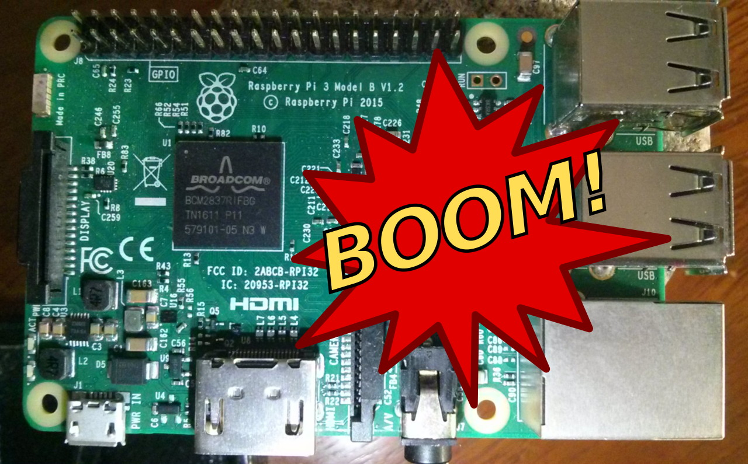
After a week nothing even compiles…
What went wrong ?!

Slide 3

Raspberry Pi 3
Small platform Linux system that costs less than $40
Model 3 has four core, 64-bit ARM Cortex A53 clocked at 1.2 GHz
No graphic card but has DVI provided by VideoCore IV GPU built in
1GB of LPDDR2-900 SDRAM
Boots from a SD card
Runs a special version of Debian known as Raspbian. Available as a card image.
There are Pi 2 and zeros (I find them too slow to use for much)
Pi-top
Company that produces laptop footprint for Raspberry Pi 2 or 3
Allows to carry and work on Raspberry Pi without all the wires everywhere
Uses yet another distro of Rasbian on SD card

Slide 4
First Disaster
Used existing ancient Pi-top distro to try to create blockchain image
SD card was 8G and had not been expanded so had only 4G
Ran Linux version out of space
Unable to start Pi-top software
What was that password anyway
Pi-top recovery
Buy new 32G SD card (larger ones sometimes are slow and it takes forever to image. And if you need 64G, why are you using a Raspberry Pi!?
New image from 2017 for Pi-top and expands automatically to 32G!
Down load yet-another-SD-card writer
Where is that SD card thingee for my Apple.
Why does it keep falling out!
Use really old one, works!

Slide 5
First Mistake (and reason for first disaster)
Decide it would be cool to connect three Raspberry Pi as peers
Set-up as version of Bitshares called Graphene and do Monopoly
Discovered build instructions: https://github.com/cryptonomex/graphene/wiki
How hard could this be?
Pi-top failures
Graphene cannot be built on newer software
Pi-top is based on older Debian version and stripped down to fit on SD cards
Pi-top is not too new and not new enough
The distro is flawed and crashes when doing long processes that update SD card.

Slide 6
Why Graphene and Bitshares are painful
Cannot build Graphene with current version of C “Boost” libraries
Raspbain comes with 56 Boost and Graphene can only use 57
Bitshares can be only compiled with 57-63 “Boost” libraries
SSH must be older version
Curses, Doxygen, and various other obscure comm libraries must be installed
So to build either Graphene or Bitshares need a special image of partially updated software
Pi-top fix
New distro for Rasbian available Nov2017 and so built yet another image on SD card (lucky I bought two on discount at Walgreens (my goto source for cheap fast SD)
Pi-top still works with new distro with slight screen sizing issue.
Crashes stop now. Two nights to 1AM trying to get previous version to work.

Slide 7
The Doomed Build
Use directions for install on old Ubuntu version 14.07 as this is well documented
Generally Ubuntu instructions work for Raspberry Pi distros
Finally managed to compile a Boost 57.
Remember this is ARM A53 so the binaries must be built
Rebuild time for Boost 57 is about four hours
Finally get to run Make on Graphene
2nd Disaster
Compile fails. Syntax issues!
Forked code from original code from Bitcoin (yes that one) crypto code blows.
Appears that definition of Big Number is undefined now
The compiler is too modern to compile old Bitcoin, but we are using C++ 4.9

Slide 8
Graphene!
Cool version of Bitshares that can do assets
No mining
Graphene is a fork of Bitshares which is a fork of Bitcoin
All code and instructions available in GitHub
As not graphical and basic C code
Disaster 3
Bitshares re-forked Graphene back (OMG)
Graphene is abandoned. How did I miss that!
Bitshares requires again strange image to compile
Look at others like Ethereum (ETH) (requires Ubunto not Debian and newest version)
There are images for SD from various websites for Ethereum for Raspberry Pi
Not willing to run an image of SD card not from a known source and most appear to be for version 2 not version 3 so two to three years out-of-date

Slide 9
Write one
Found cool Python example!
Even has proof-of-work (mining)
https://medium.com/crypto-currently/lets-build-the-tiniest-blockchain-e70965a248b
Only works on Python 3.6.4 but have 3.6.2 (Apple) and much worse on Raspberian
Decide to write small example in Go language
Disaster 4
Visual Studio Code appears to have issues with Go for Apple (works perfect on Windows)
Other editors are available but all seem to have issues (loaded three different ones)
Go just is a no-go for Linux based systems
Surrender
Saturday morning 1AM

Slide 10

Questions?

